Slide 1

Exploring Lightweight Evaluation Metrics for Information Retention On ASR Outputs Beyond WER
Conversational Speech Processing
Seminar FS25, UZH
Ishana Rana
Notes:
For this seminar paper I wanted to research a bit more on ASR systems
Therefore, I focused my paper on exploring lightweight evaluation metrics for information retetntion on ASR output beyond just WER

Slide 2
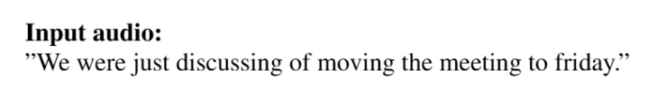
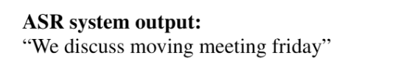
Problem Introduction
Standard evaluation metric in ASR: WER
+ literal word-for-word transcriptions
- ignores semantic/structural/linguistic similarity
Downstream applications
Voice assistants, human machine interaction, Scheduling assistant
Notes:
Wer = computed by aligning the predicted transcript with a reference and then calculating the proportion of words that are substituted, deleted or inserted.
Dictation/ captioning systems

Slide 3
Relevant Work
Reference-based comparisons
Without reference
Semantic similarity
Multimodial embeddings
LLMs
Gautam et al. (2024)
BLEU, ROUGE and BERTScore
Evaluate Whisper-generated transcriptions of soccer game audio commentary
Downstream tasks: event detection, game summarization
Kim et al. (2021):
Semantic distance embeddings
How much meaning lost
Ngai and Rudzicz et al. (2023)
Severity measures to score ASR errors
Impact on downstream sentiment & meaning
Waheed et al. (2025)
Multimodal embeddings & learned proxies
Phukon et al. (2025)
Combined with phonetic, semantic & inference-based components
For speech clarity
Computationally expensive
Training & inference from large transformer models
Notes:
There has been a lot of research investigating evaluation methods with different approaches
I found some that are recent and also share some ideas with my paper
So basically two approaches

Slide 4
The focus in this paper
Scope:
conversational speech (AMI meeting corpus)
Different meeting types
Aim
Evaluating and comparing performance of scores on same data
NOT its effect on downstream model performance
Lightweight
Faster, less memory and computational power
Low resource settings – prototyping, quick evaluation, classroom projects, etc.
Notes:
Common with previous papers:
Interest in semantically oriented ASR evaluation

Slide 5
Experimental Setup
Dataset
AMI: ES2016a-d), EN2009c-d)
Manual annotations: *.words.xml, *.segments.xml, *.ne.xml
Models
ASR: Whisper base variant
NER: Bert, Roberta, spaCy_sm, spaCy_trf
Github
https://github.com/Juiceifers/Beyond_WER_in_ASR

Slide 6
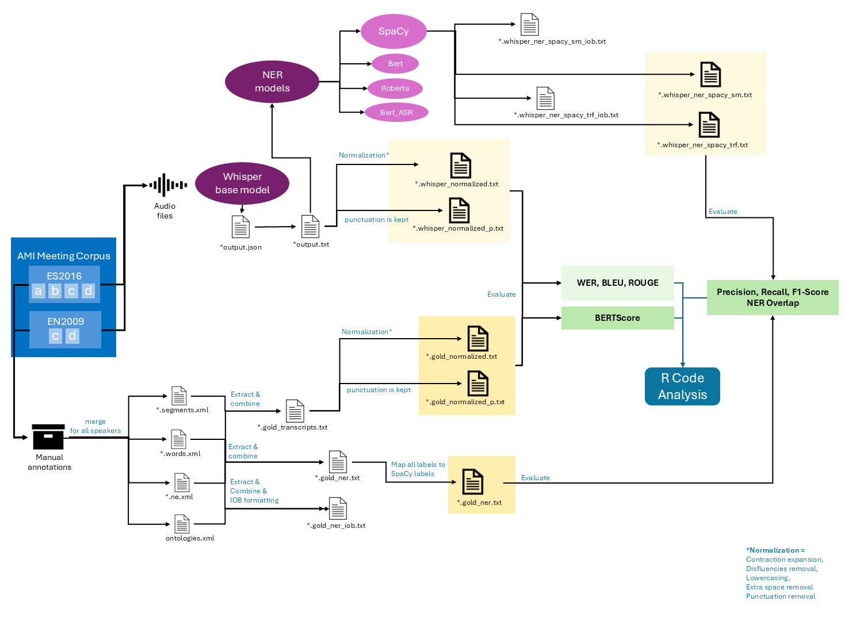
Work

Slide 7
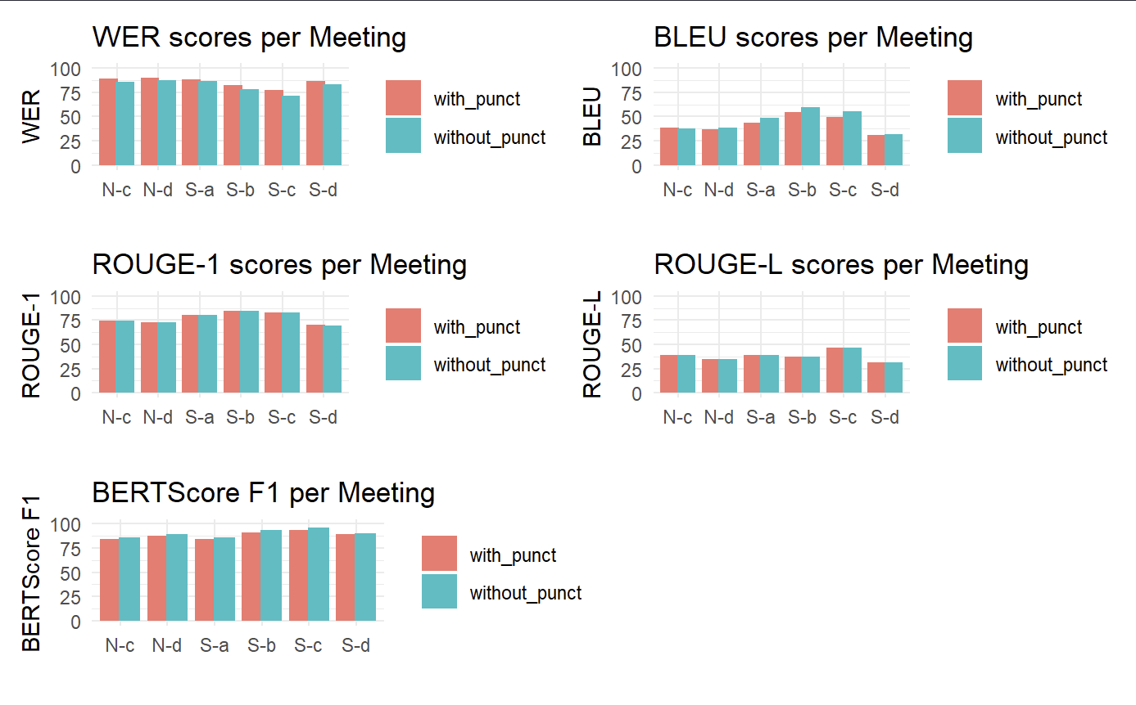
Results
transcription_results_evaluation.Rmd
transcription_results_evaluation.pdf

Slide 8
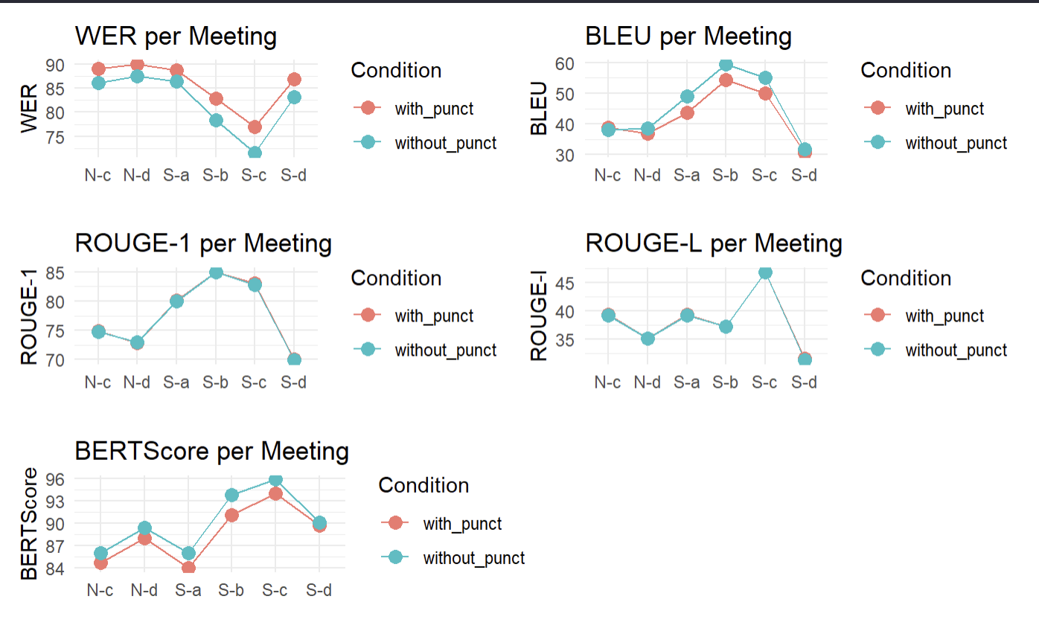
Results
transcription_results_evaluation.Rmd
transcription_results_evaluation.pdf
plotting_average_metric_scores.Rmd

Slide 9
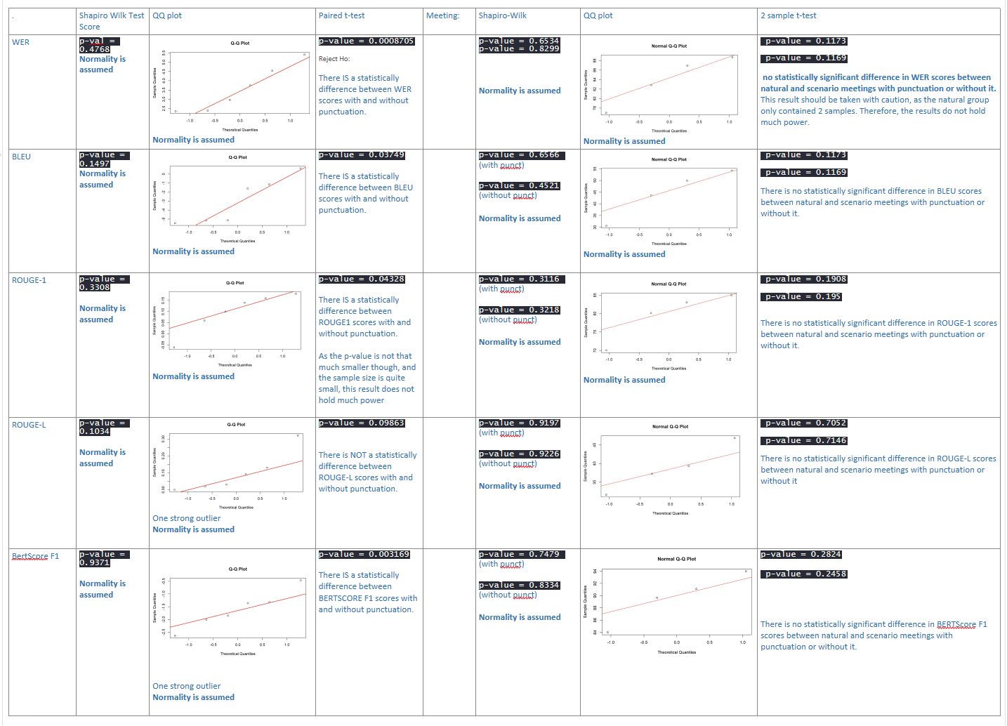
Results
Hypothesis_Testing.Rmd
Hypothesis_Testing.pdf

Slide 10
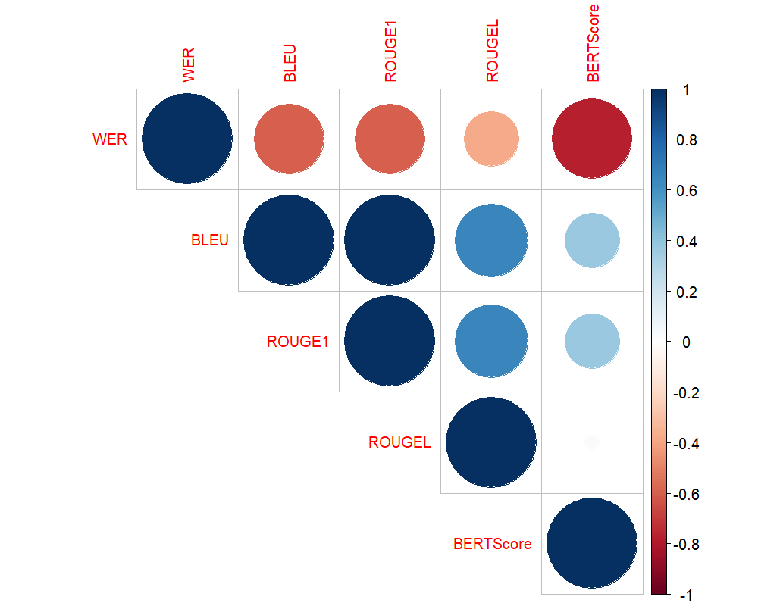
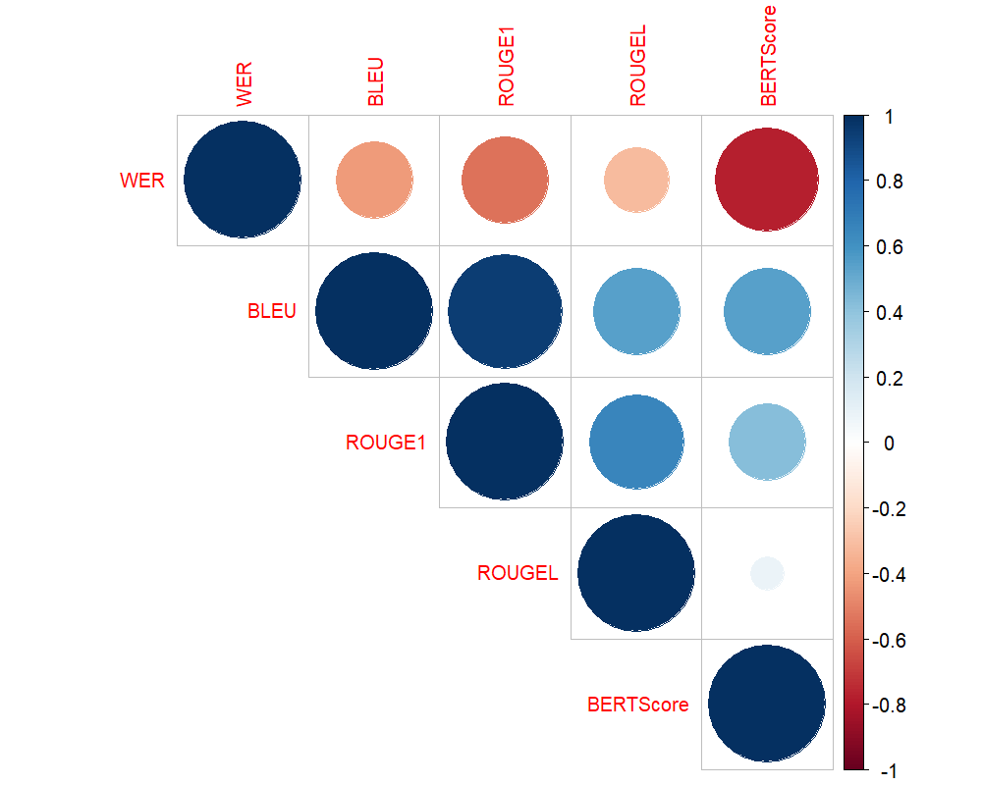
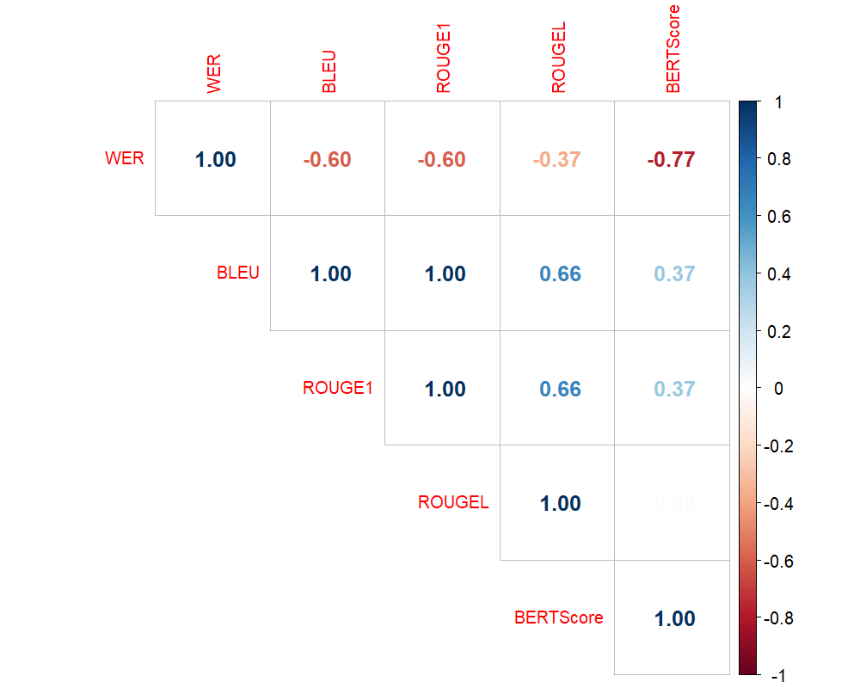

Results
multivariate_analysis.Rmd
multivariate_analysis.pdf

Slide 11
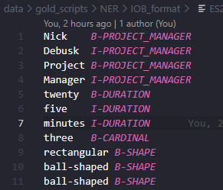
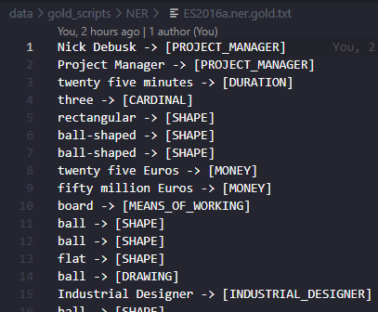
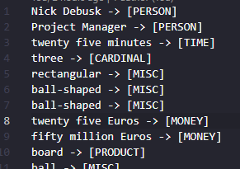
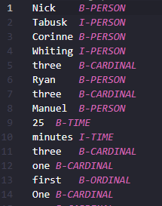
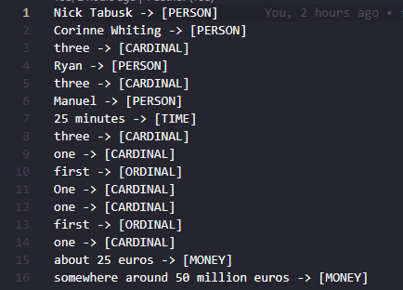
Results – NER

Slide 12
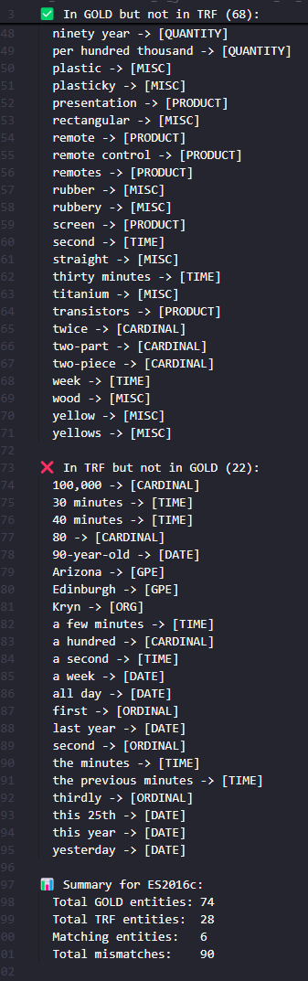
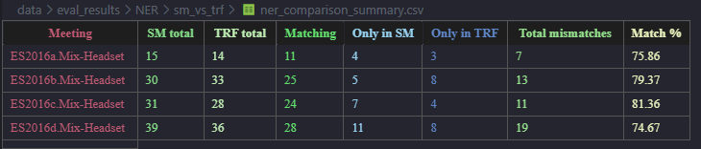
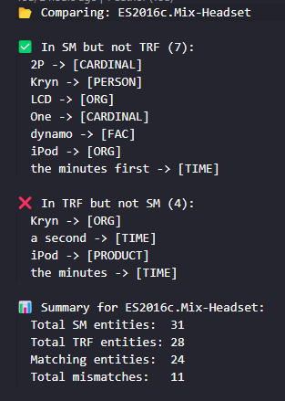
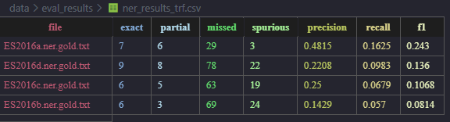
Results –
NER

Slide 13
Core of paper
Exploring alternative ASR evaluation metrics beyond WER
That better capture semantic informational content
BLEU, ROUGE-1, ROUGE-L, BERTScore, NER overlap
Leveraging open-source, freely available tools
Whisper, SpaCy, BERT, RobERTa
Analyzing effects of punctuation and meeting types
Used statistical tests

